Slide 1
Chromebook Care
West Side Elementary

Slide 2
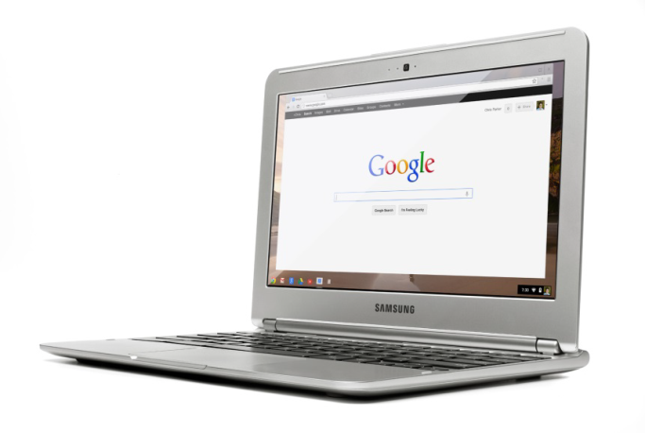
Elkhorn Elks...
Be Respectful
Be Responsible
Be Productive
Be Safe
...With your Chromebook!

Slide 3
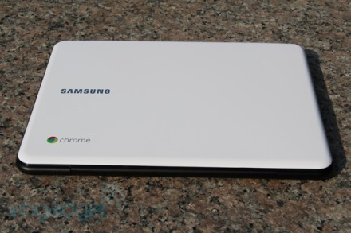
Be R-e-s-p-e-c-t-ful
Use only your Chromebook, or your loaner Chromebook, no one else’s! Stay Signed IN!
Lids down when the teacher is talking, or when class is in progress.
Three or more warnings could result in an office referral or limited Chromebook use.
**This is what it should look like with “lids down”; give your full attention to your teacher!

Slide 4
Be Responsible
Always pay attention to where your Chromebook is.
If you leave your Chromebook somewhere unattended, and it is found by a teacher, you will receive a “strike”. Three strikes could mean a consequence. If you lose your Chromebook and it is not found, you will have to pay to replace it!
The school can track anything you do (even emails!), so be careful how you use your Chromebook. Even if you ‘clear’ your history, the school can still see it. Even if you’re at home, the school can still see it.
Inappropriate Chromebook use, inappropriate emails, and/or inappropriate website use will result in consequences, up and including suspension of Chromebook use.

Slide 5
Be Responsible

Slide 6
Places Chromebooks have been found unattended:
On the bus
Library
Hallways
Classrooms
Etc.
DON’T LEAVE YOUR CHROMEBOOK ALONE!!!

Slide 7
Be Productive
Use your Chromebook only for school-related tasks.
Google Classroom
Google Docs
Teacher-approved websites
Researching for a project/paper for class
Use your email for school-related topics.
Ask teachers or other students about homework/assignments
Turn in assignments
Have assignments sent to you

Slide 8
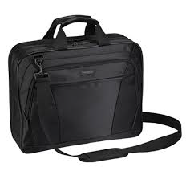
Be Safe
Always carry your Chromebook in its case! (It should not just be in your backpack.)
Transport your Chromebook with the lids closed.
No food or drink around your Chromebook!
Always watch your Chromebook – it is your responsibility!
Be gentle with the Chromebook as you use it.
If your Chromebook is damaged, you will be responsible for bringing it to the library for repairs!
If your Chromebook is lost, you will have to pay to have it to be replaced!

Slide 9
Remember…
These Chromebooks are not yours; treat them with respect and care.
You are the CARETAKER for the year not the OWNER
You are responsible for anything that happens to your Chromebook.
Keep your Chromebook safe at all times!

Slide 10
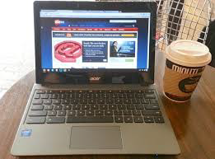
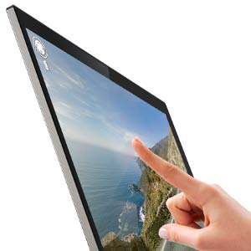
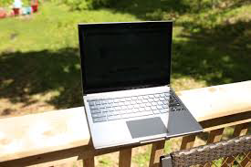
Chromebook ‘Don’t’:

Slide 11
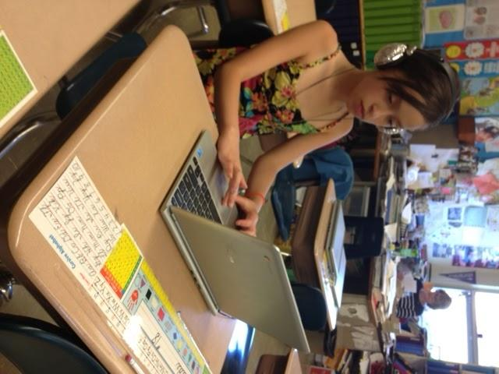
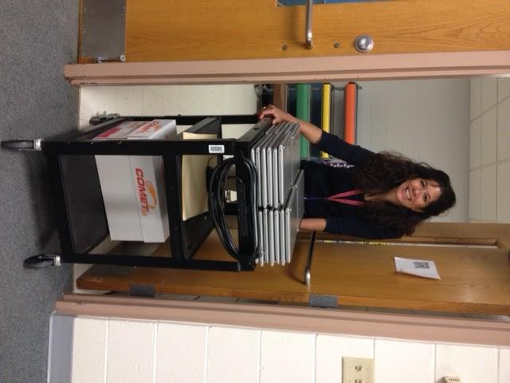
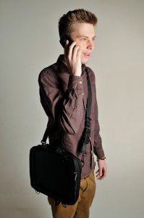
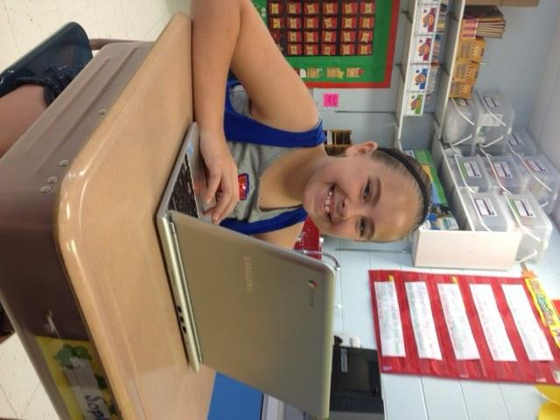
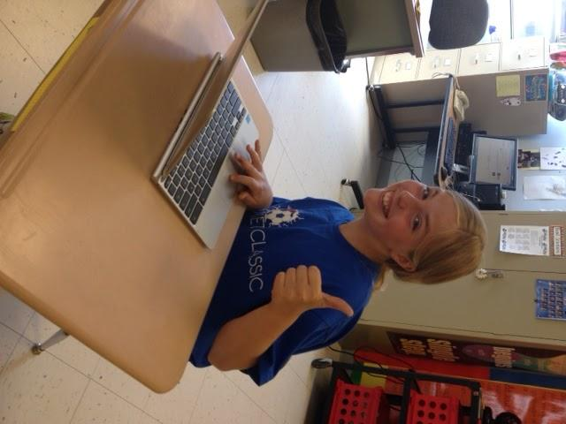
Chromebook “Do”

